Slide 1


Presidency
Presidency
School of Artificial Intelligence and Advanced Computing

Slide 2
Unified Security Scanner + RAG Assistant
CSS7102- Mini Project Review-1
Batch Number : CCS_13
Under the Supervision of,
Dr. Hashmat Fida
Assistant Professor
School of Computer Science and Engineering
Presidency University
Roll Number | Student Name
20231CCS0117 20231CCS0125 20231CCS0116 20231CCS0173 | Roopashree M Mohammed Rayyan Khan Shreya Syeda Zaiba
Name of the Program: CCS-Computer Science & Engineering (Cyber Security)
Name of the HoD: Dr. Sampath A K
Name of the Program Project Coordinator: Dr . Sampath A K
Name of the School Project Coordinators: Dr. Sampath A K

Slide 3
Content
Problem Statement
Github Link
Analysis of Problem Statement
Timeline of the Project
References

Slide 4
Problem Statement Number: PSAIAC_214
Organization: Presidency University
Category : Software
Difficulty Level: High
Problem Description: Analysts juggle many scanners; build a unified GUI + RAG
assistant across Nmap/OpenVAS/Nessus/Nuclei.

Slide 5
Github Link
https://github.com/Roopashree1926/Unified-Security-Scanner-RAG-Assistant.git

Slide 6
Analysis of Problem Statement
Existing Problems
Organizations use multiple security tools separately.
Vulnerability reports are difficult to interpret.
Manual security analysis consumes significant time.
Proposed Solutions
Develop a unified security platform that:
Integrates multiple scanners.
Uses AI to explain vulnerabilities.
Suggests remediation steps.
Generates automated reports.
Allows users to ask security-related questions.

Slide 7
Analysis of Problem Statement
Proposed System Advantages
Unified interface for multiple security scanners
AI-powered vulnerability explanation
Faster security analysis
Reduced manual effort
Beginner-friendly interface
Automated remediation suggestions

Slide 8
Analysis of Problem Statement
Component | Technology / Tool | Purpose
Frontend | React.js, JavaScript | Develop an interactive and responsive user interface
Backend | FastAPI (Python) | Develop REST APIs and handle application logic
Security Tools | Nmap, OpenVAS, Nessus, Nuclei | Vulnerability Scanning
AI Model | Google Gemini API | Generate AI-powered explanations and remediation suggestions
RAG Framework | LangChain | Retrieve relevant cybersecurity knowledge and generate accurate responses
Vector Database | FAISS | Store and retrieve embeddings for the RAG assistant
Database | PostgreSQL | Store user information, scan history, and reports

Slide 9
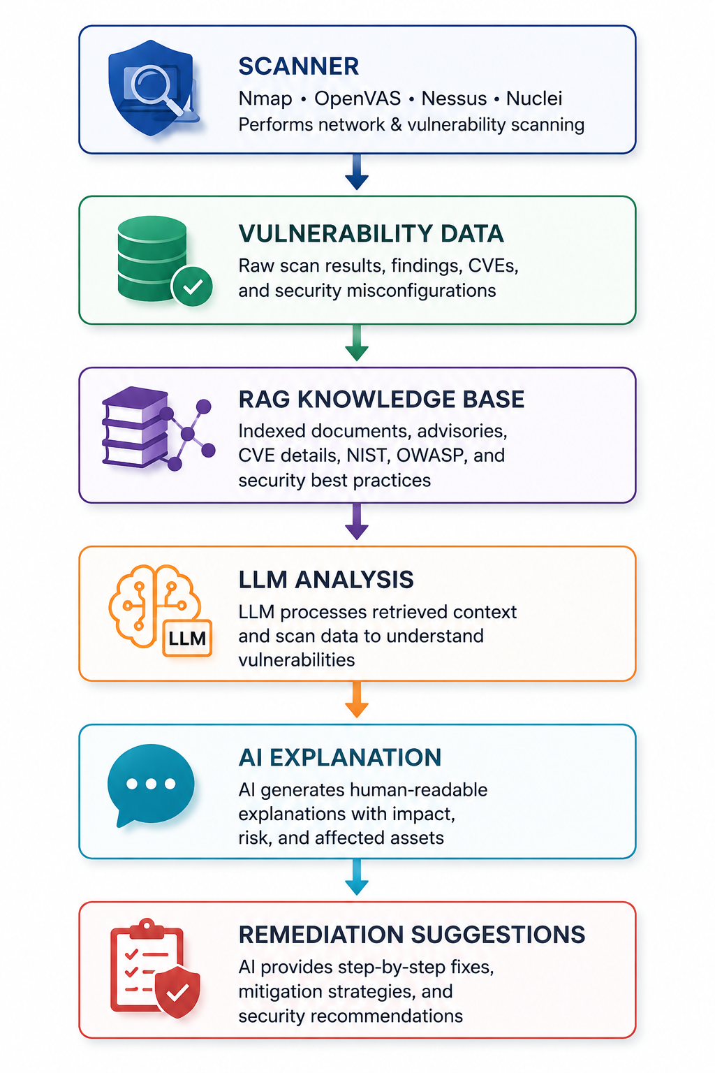
Proposed System Workflow

Slide 10
Timeline of the Project (Gantt Chart)
Activity | W1 | W2 | W3 | W4 | W5 | W6 | W7 | W8 | W9 | W10
Literature Survey & Research | █ | █
Requirement Analysis |  | █ | █
Architecture Design |  |  | █ | █
Frontend & Backend Development |  |  |  | █ | █ | █
RAG & AI Integration |  |  |  |  | █ | █ | █
Testing |  |  |  |  |  |  | █ | █
Documentation |  |  |  |  |  |  |  | █ | █
Final Review |  |  |  |  |  |  |  |  |  | █

Slide 11
References (IEEE Paper format)
Research Paper
OWASP Foundation. (2025). OWASP Top 10: Web Application Security Risks. https://owasp.org/www-project-top-ten/
Documentation
Google AI. (2025). Gemini API Documentation. https://ai.google.dev
LangChain Inc. (2025). LangChain Documentation. https://python.langchain.com
Nmap Project. (2025). Nmap Network Security Scanner. https://nmap.org
ProjectDiscovery. (2025). Nuclei Documentation. https://docs.projectdiscovery.io
Greenbone Networks. (2025). OpenVAS Documentation. https://greenbone.github.io

Slide 12


